Slide 1
Database Normalizarion:
Basic Concepts

Slide 2
Normalization
Normalization: a process for analyzing the design of a relational database
Database Design - Arrangement of attributes into entities
It permits the identification of potential problems in your database design
Concepts related to Normalization:
KEYS and FUNCTIONAL DEPENDENCE

Slide 3
Types of Key
Primary Key: A unique key is an attribute or a set of attributes that has been used by the DBMS as the identifier of a table.
Candidate (Alternative) Key: An attribute or a set of attributes that could have been used as the primary key of a table.
Secondary (Index) Key: An attribute or a set of attributes that has been used to construct the data retrieval index.
Concatenated (Combined or Composite) Key: A set of attributes that has been used as the key.
Foreign Key: An attribute or a set of attributes that is used as the primary key in another table.

Slide 4
Database Normalization
Normalization: The process of structuring data to minimize duplication and inconsistencies.
The process usually involves breaking down a single Table into two or more tables and defining relationships between those tables.
Normalization is usually done in stages, with each stage applying more rigorous rules to the types of information which can be stored in a table.

Slide 5
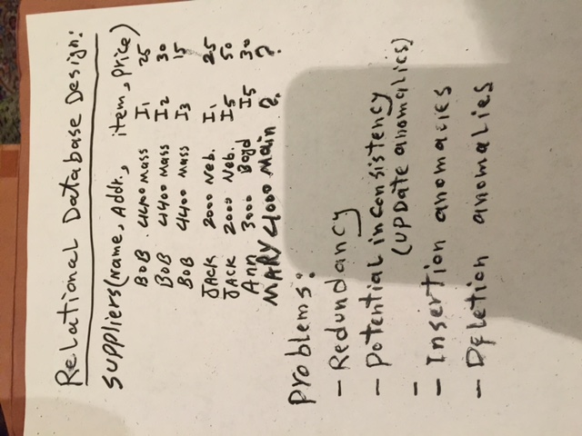

Slide 6
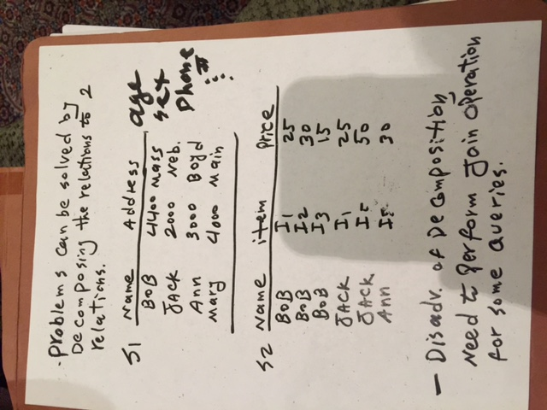

Slide 7
Normalization
A data base is a model or an image of the reality.
Logical Data Base Design is a process of modeling and capturing the end-user views of an application domain and synthesis them into a data base structure.
Normalization is a logical data base design method.
The basis for normalization is the functional dependencies among attributes in a table.

Slide 8
Purposes of Normalization
Avoid maintenance problems such as Update .
Insert: There may be no place to insert new information.
Delete: Some important information will be lost by deletion.
Update: Inconsistency may occur because of the existence of data redundancy.
Provide maximum flexibility to meet future information needs by keeping tables corresponding to object types in their simplified forms.

Slide 9
A Common Sense Approach to Normalization
Don't rush to put all the information in one table.
Create a table to correspond to a class of a simple object type that should exist by itself, i.e., "one fact in one place."
Include common fields (links) as ways of joining information from several related tables.
Avoid redundancy by using links to retrieve data from related tables.

Slide 10
Normalization: Pros and Cons
Pros
Reduce data redundancy & space required
Enhance data consistency
Enforce data integrity
Reduce update cost
Provide maximum flexibility in responding ad hoc queries
Cons
Many complex queries will be slower because joins have to be performed to retrieve relevant data from several normalized tables
Programmers/users have to understand the underlying data model of an database application in order to perform proper joins among several tables
The formulation of multiple-level queries is a nontrivial task.

